Slide 1

Python Boot Camp
by Sukanta Maikap

Slide 2
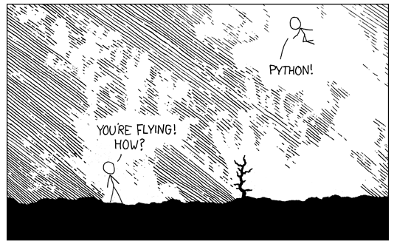

Why should you learn Python?

Slide 3
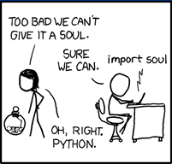
Batteries included….
Comes with rich and vibrant standard libraries :
Scientific Programming
Numerical Analysis
Education
Astronomy
Big Data Analysis
Machine Learning
Web Development
Visualization
---- and many many more!!!!
Notes:
This philosophy says

Slide 4
Part I :
A Crash Course in Python
(by comparing and contrasting with Java)
Notes:
We will learn about python by comparing and contrasting it with Java (as all of us here are well versed in Java, I hope)
Introduce the python command line tool

Slide 5


Baiscs
Interpreted Language.
Supports Object Oriented Programming.
Dynamically Typed
Block or scope is defined by : and indentation
Module ~ Package
Notes:
>>>val = 98.3 [Explain, 1. Literal (There are no primitive types in python, all are objects. Interpreter automatically converts it to a float object) 2.
>>> # introduce for
>>>for i in [1,2,3,4,5,6,7,8,9,10]:
... print(i)
...

Slide 6
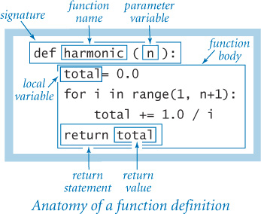
Methods / Functions in Python
Dynamically typed : so no type for parameter(s)
Dynamically typed : so no type for return value
Documentation is extremely important here
Misuse can only be caught at runtime
Default return value : None*
* more on this later
Notes:
Informal convention
Functions : for standalone methods
Methods : members of a class

Slide 7
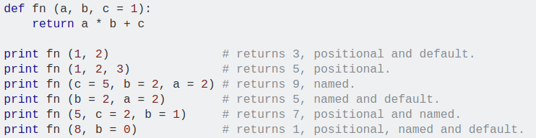
Positional & Keyword Argument
Positional Argument : traditional way of matching value with the params.
Keyword Argument : by explicitly assigning a value to the parameter.
Notes:
>>> def sum(a, b=1, c=1):
... return a+b+c
...
>>> sum(1)
3
>>> sum(1, b=10)
12
>>> sum(1,2, 3)
6
>>>

Slide 8
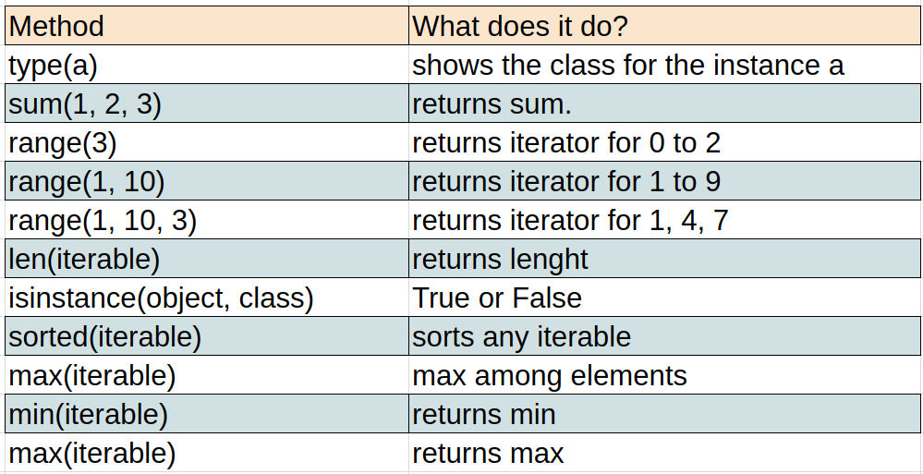
(some) Python Built-in Functions

Slide 9
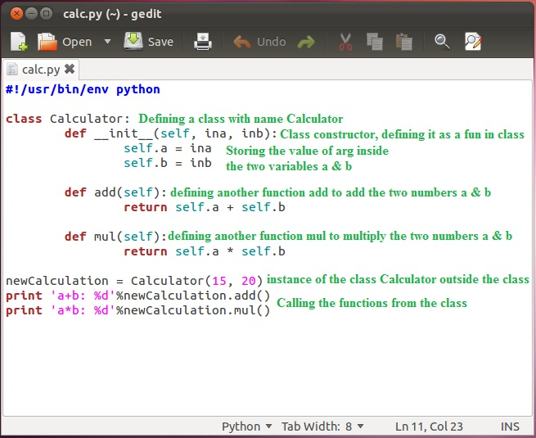
Class in Python
Notes:
Inheritance : class x (Object)

Slide 10
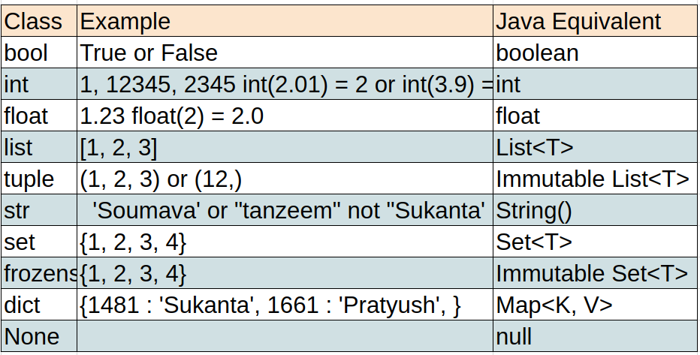
(some) Python’s Built-in Classes
Notes:
For array, look at NumPy.
# introduce list operations
#introduce set operations
Quiz :
>>> test = {1, 2, 2} - > what will be the value of test?
#introduce dictionary operations

Slide 11
Exception & Exception Handling
Conceptually similar to Java
Instead of throw use raise
Instead of try catch use try except
Notes:
>>> def foo():
... raise ValueError('Ta Da')
>>> try:
... foo()
... except ValueError:
... print('ya got me !!')
...
ya got me !!

Slide 12
Packing and Unpacking Sequences
What will happen here ?
>>>a = 1, 2, 3, 4, 4 # what is the type of a?
>>> m, n, o = 4, 5, 6
>>> a, b, c, d = range(7, 11)
>>> a, b, c, d = range(7, 12)
How can you swap 2 values ?
What would be the value of a & b after this operation?
>>> a = 1
>>> a, b = 2, 3
>>> a, b = b, a+b

Slide 13
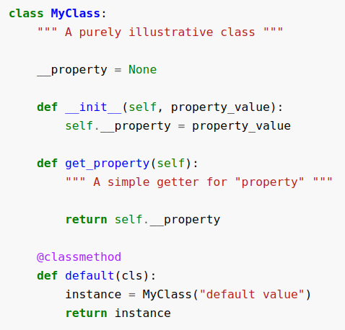
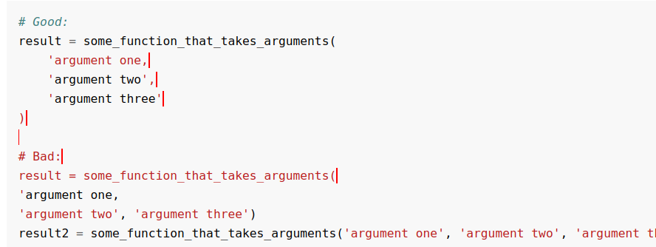
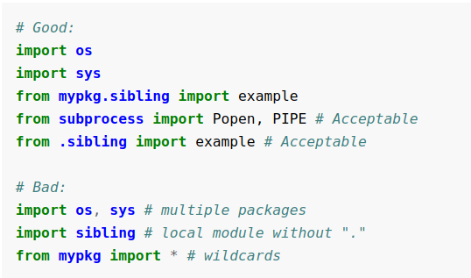
Style Guide
PEP8 :
* cheatsheet

Slide 14
Part 2 : Problems
(Let’s learn by doing ...)

Slide 15
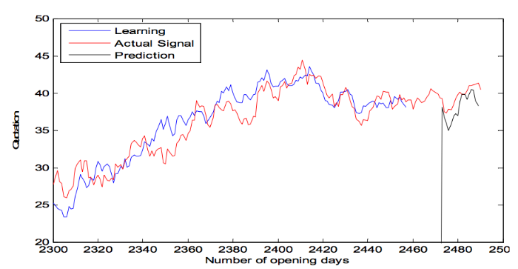
Problem 1 : Predict Stock Price
Notes:
Introduce numpy, matplotlib and sckit-learn

Slide 16
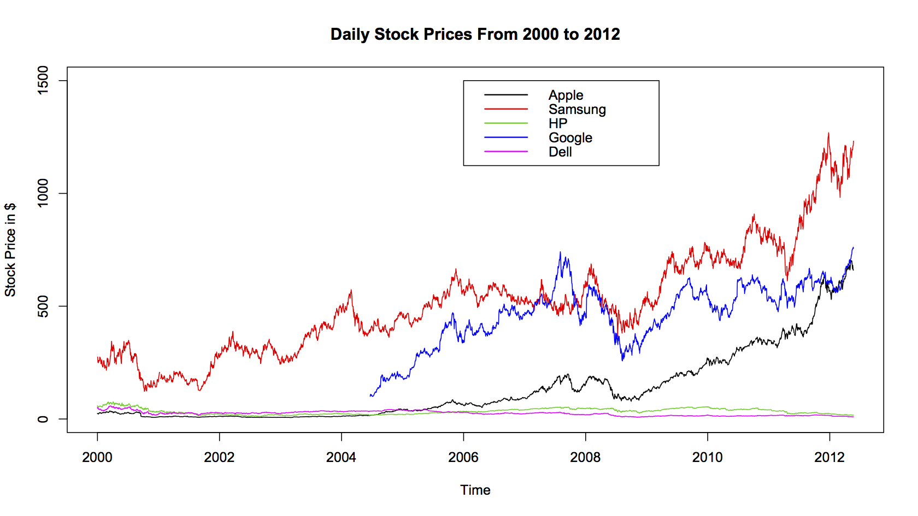
Problem 2 : Stock Screener - compare multiple stocks

Slide 17
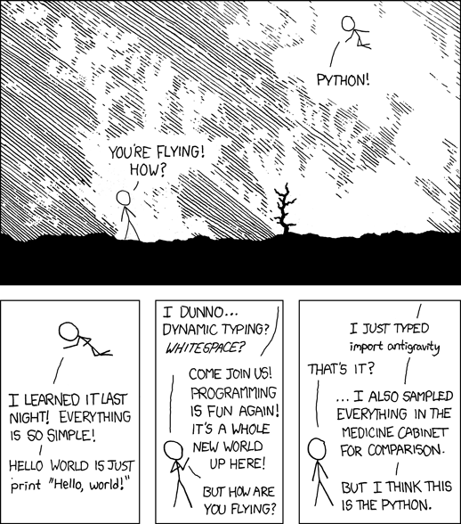
Notes:
5 main types in python : Number, Tuple, List, Dictionary

Slide 18

Q&A
Notes:
5 main types in python : Number, Tuple, List, Dictionary

